Slide 1

Ben Benyehuda
Timothy Glisson
Braden Cariaga
Henry Thiel
Business Analyst
Business Analyst
Computer Scientist
Computer Scientist

Slide 2

Who is PEO STRI?
The Program Executive Officer for Simulation, Training and Instrumentation (PEO STRI) is a leader in delivering unmatched testing, training and information operations capabilities to enhance operational readiness in support of our national defense.

Slide 3
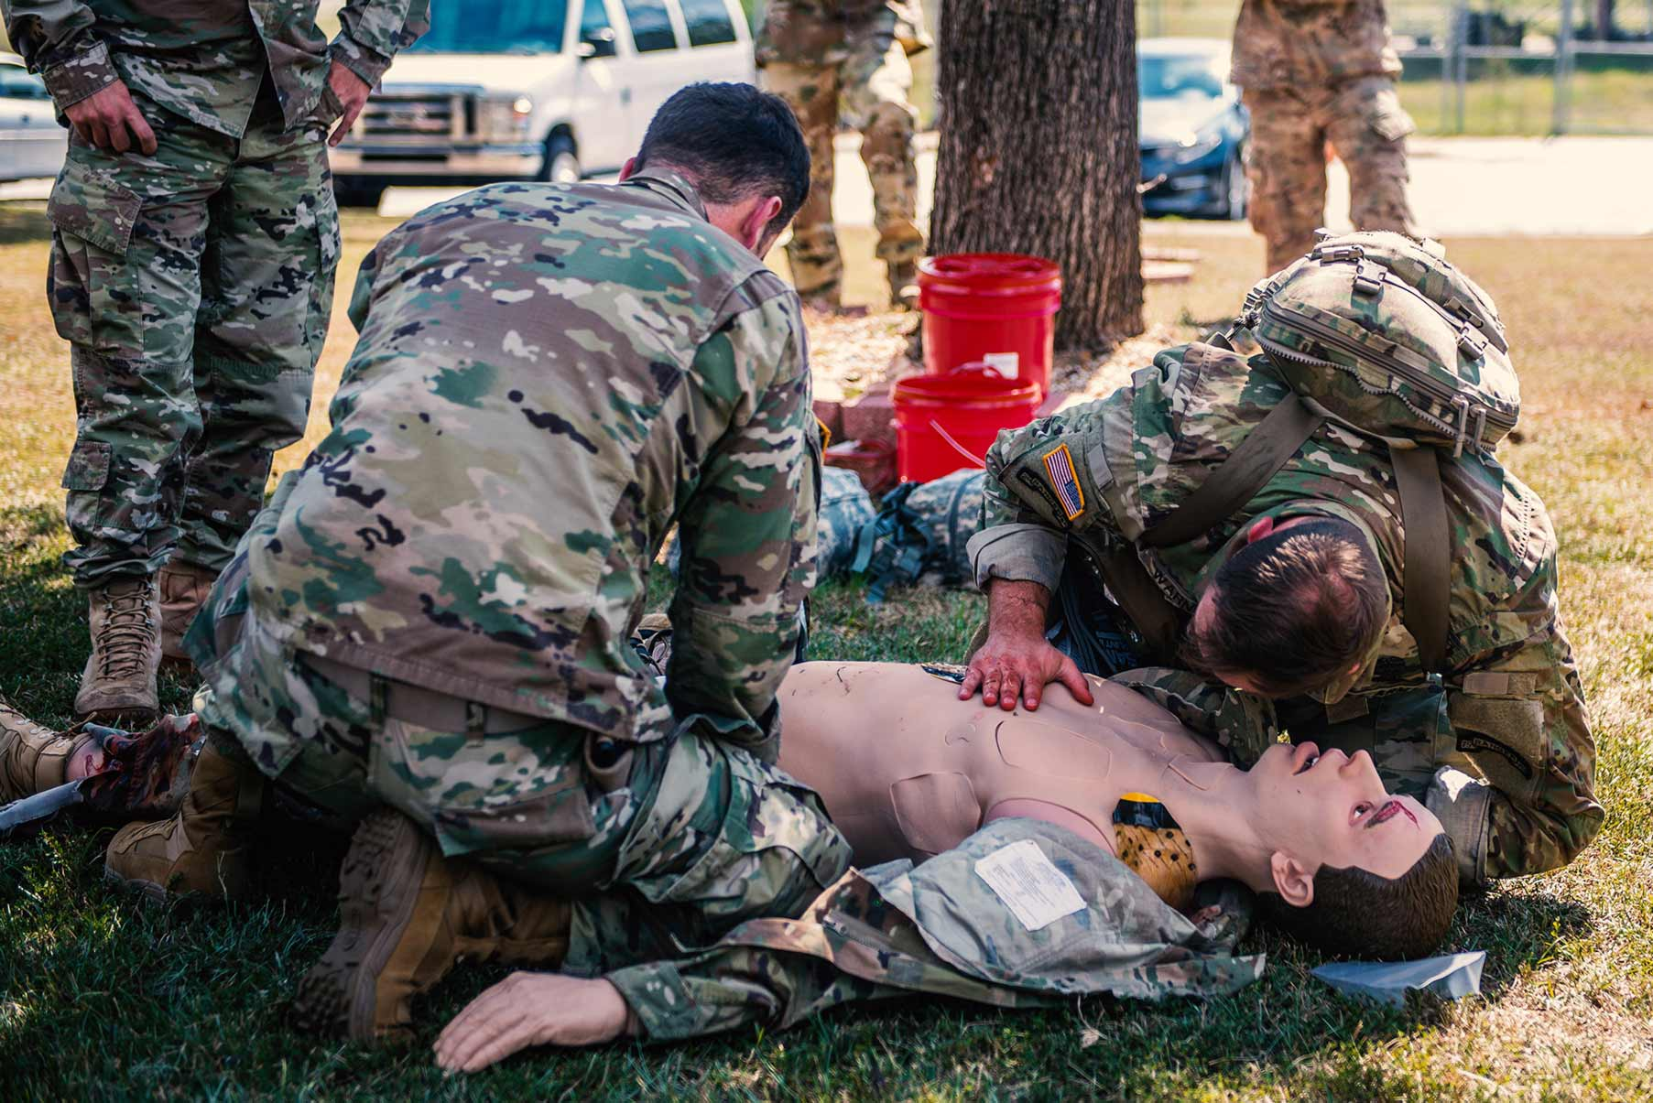
Project Purpose
We are developing the software tool that will enable PEO STRI logistics department to monitor the progress of equipment going through the various regulatory steps, starting with the initial acquisition through the end of the life cycle for that equipment.
Multiple capstone teams from universities around the state of Florida are working on various software tools to work together in an environment to improve the efficiency of PEO STRI in acquiring training tools from contractors and getting them to the soldiers that need them.

Slide 4

Project Goal
Creating a single software package that will help track the process of all the steps needed to send out training equipment to the training unit.
A system that will be able to identify delays along the chain of command, and alert the sponsor to fix the delaying issue
The end goal is to improve and shorten the bureaucratical steps needed to begin training and making sure our troops are prepared for the battlefield.

Slide 5
Integrated Product Support
Life Cycle Sustainment Plan (LCSP)
Analysis of Product Support Alternatives (APSA)
Logistics Product Data (LPD)
Technical Manuals
New Equipment Training (NET)
Facilities Report (if applicable)
Sustainment Quad Chart (SQC)
WCLS Funding
Transition to Maintenance Checklist

Slide 6
Material Release
Safety Confirmation
Statement of Sustainability
Statement of Supportability
Programmatic Environmental, Safety, and Health Evaluation (PESHE)
Health Hazard Report
Transportability Statement

Slide 7
Material Fielding
Memorandum of Notification (MON)
Material Fielding Plan (MFP)
Material Fielding Agreement (MFA)
Fielding Basis of Issue (BOI)
National Stock Number (NSN)
Material Component List (MCL)
Transfer/Issue Document

Slide 8
Major Tasks
CS – Produce a web application to manage and progress projects
File management
Automatic project notifications
Project dashboard and data views
DSBA – Improving the current process of task to be
Faster
Efficient
Easy to track ongoing processes

Slide 9
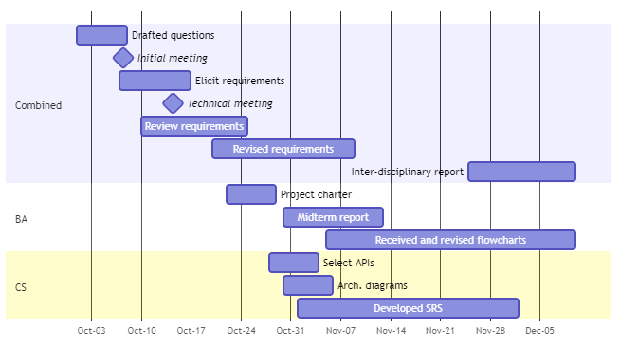
Gantt Chart – Semester 1

Slide 10
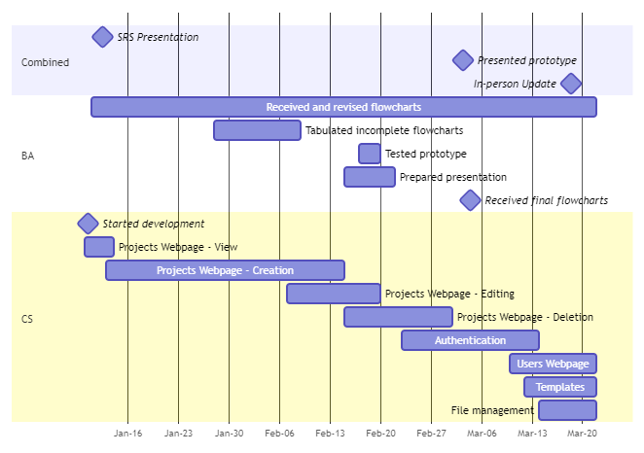
Gantt Chart – Semester 2

Slide 11
Gantt Chart – In Progress
Business Analysts:
Working on the dashboard views
Time estimations of each process
Computer Scientists
Finalize users webpage
Complete template management and processing
Implement file management

Slide 12
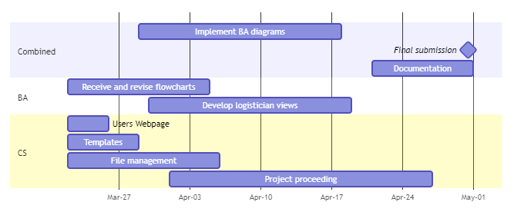
Gantt Chart – Future Plans

Slide 13

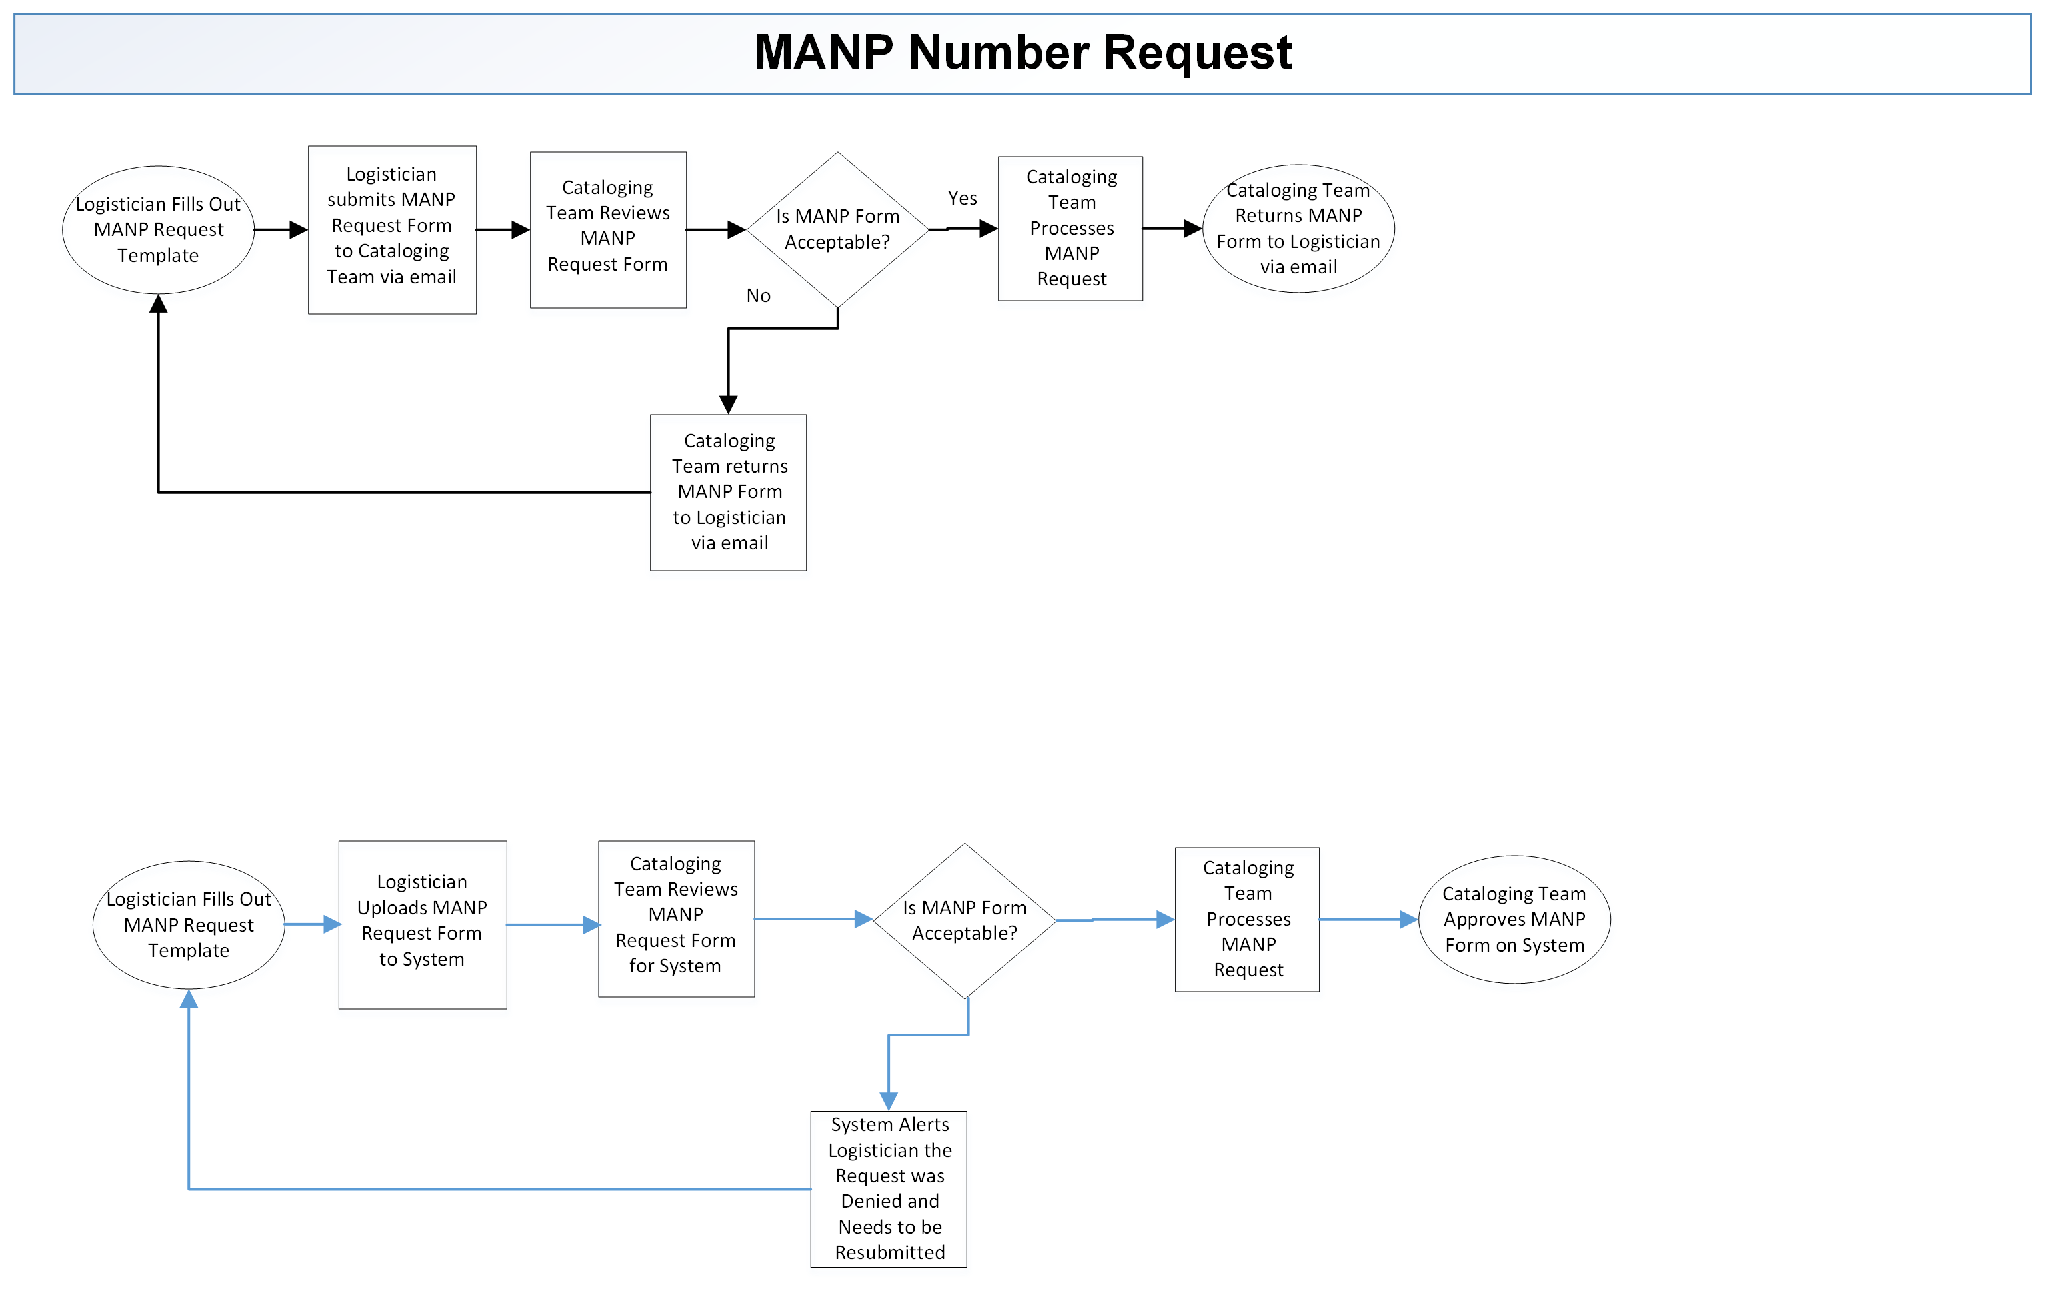
Current process vs. Improved process

Slide 14
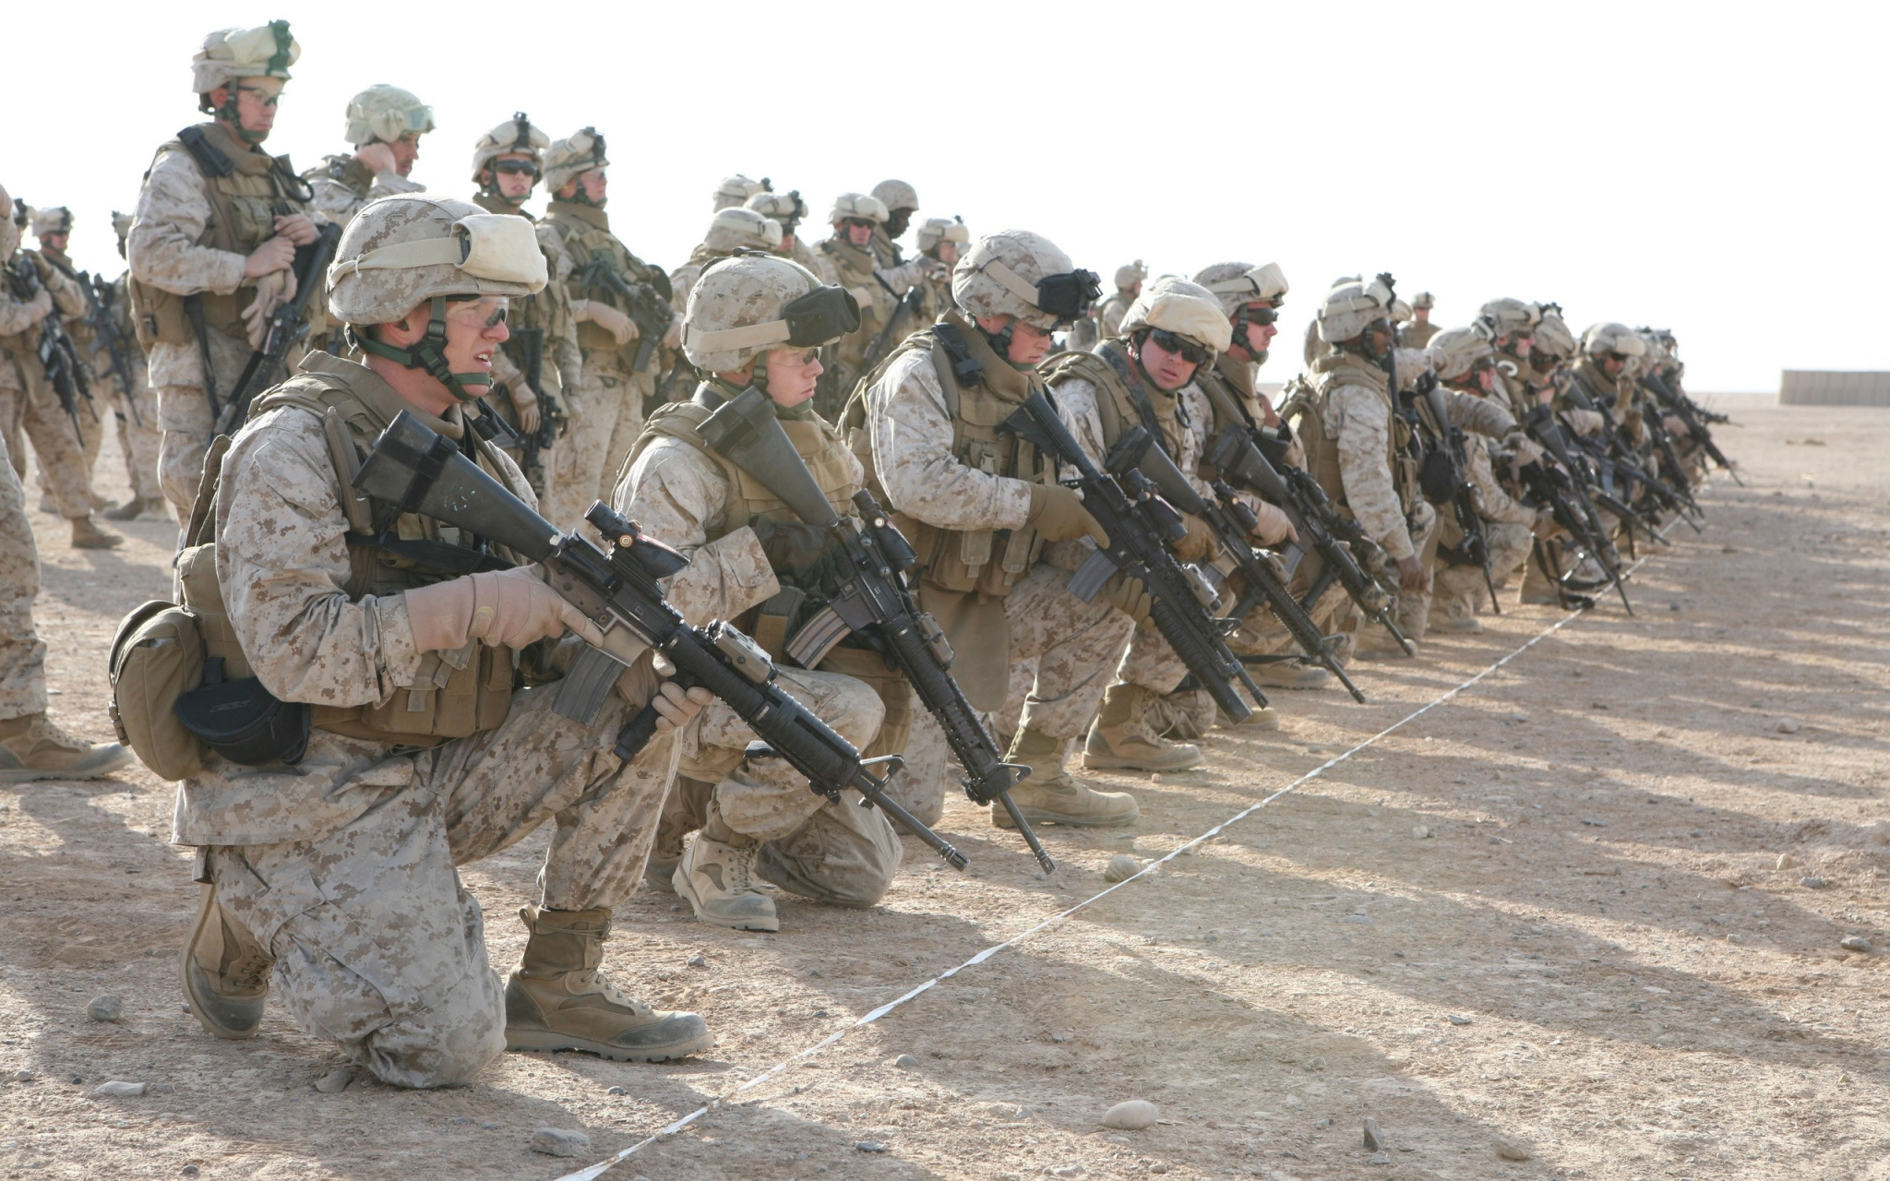
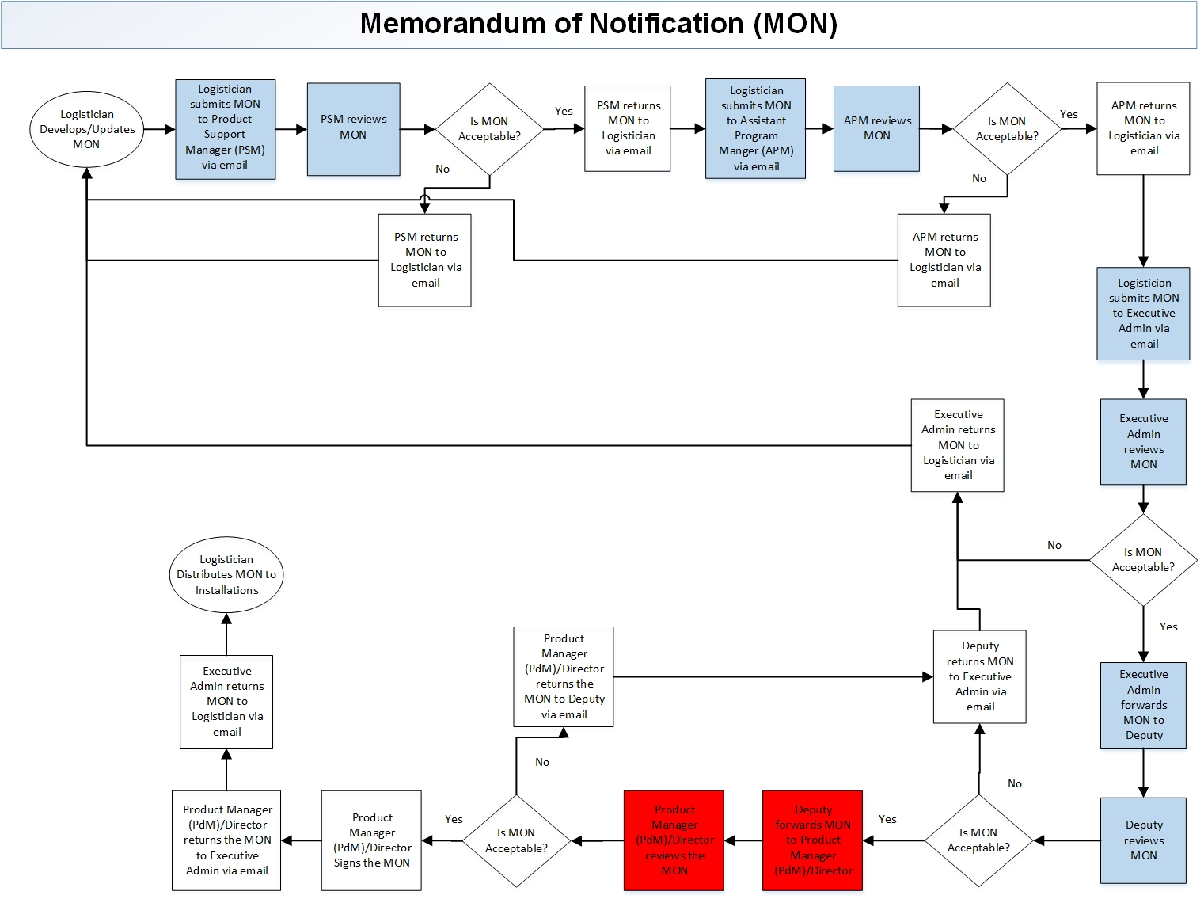
Current flowchart of process

Slide 15
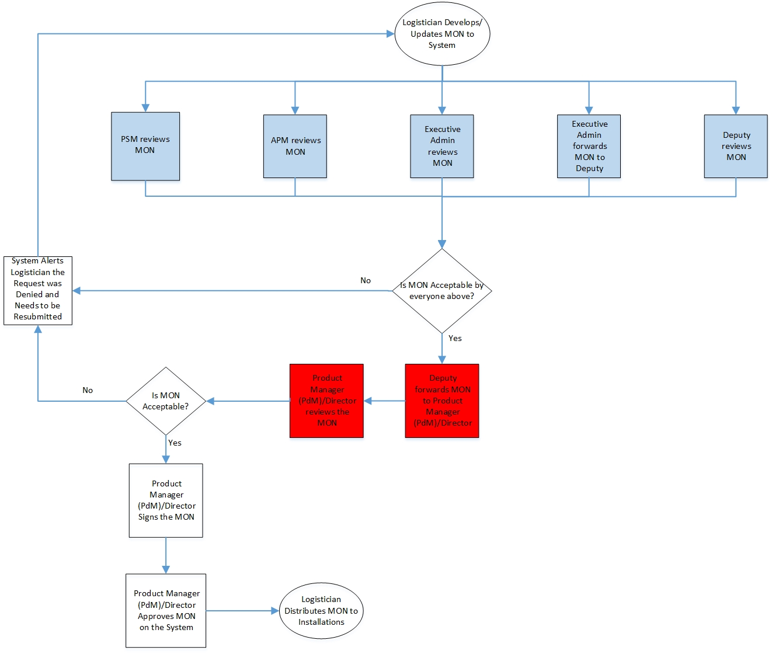
Improved process via system

Slide 16

State of the Development
Present
User Authentication & Administration
Logistical Data Population
Project Proceeding
Project Administration
Template Administration
User Permissions

Slide 17
Integrating Improved Process Flow
We can implement the improved process flows into the system using the template administration.
The templating system supports:
Module Templates – A set of tasks which can be reused across multiple projects.
Project Templates – A set of modules, or module templates which can be reused during the creation of projects.
Templates will be utilized during the project creation process in two ways:
Create a project based on a project template.
Add a module to a project based on a module template.

Slide 18
Backend Testing
Input Validation Unit Testing
Automated Blackbox System Testing
Store structure description data
Check elements of passed document match stored structure
Throw error if invalid structure is passed
Errors detectable during development
Send HTTP requests to the backend
Uses edge-case test data
Invalid documents are also tested
Reponses from the server are validated
Checks status code, headers, body type and body fields.

Slide 19

Frontend Testing (User Study)
Objective 1: Identify any faults or failures in the components and their integration with each other. (Unit Testing)
Objective 2: Identify shortcomings in the intuitiveness and usability of the application.
Testing Objectives
Objective 3: Identify faults in the design and styling of components.
Objective 4: Identify faults or failures in the integration of the client and server.
(Integration Testing)

Slide 20
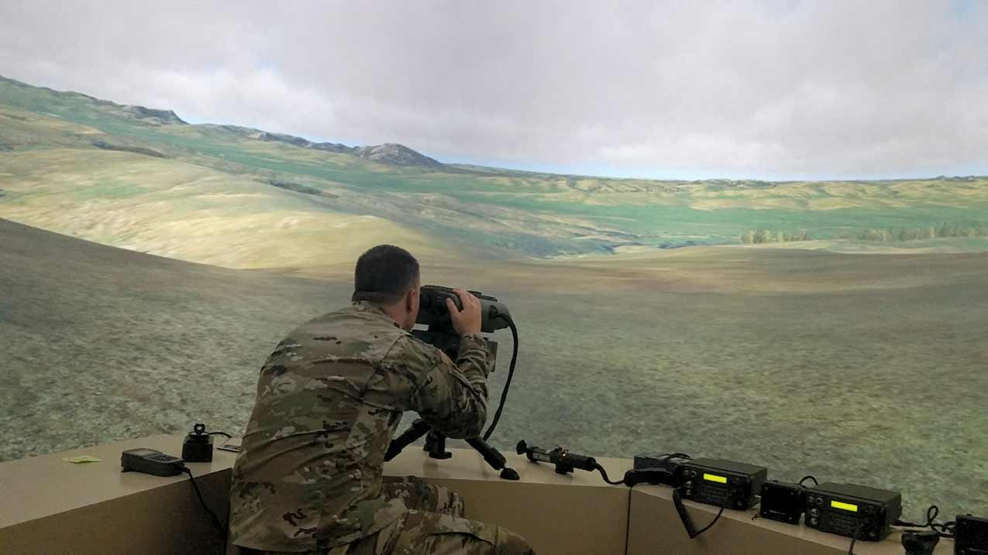
Remaining Critical Items
Determine what is needed on the user dashboard.
Create dashboard using the React JS plugin from Plotly.
Assist CS members in app design, keeping it streamlined and simple.
Create the Master Template that will be comprised of all the processes that we have received.
Test the system for bugs and other errors.

Slide 21
Remaining Development Items
01
Project Proceeding
02
User Permissions
03
Logistical Data Population
04
User Tutorials and Help Guides

Slide 22
Immediate Next Steps
Computer Science
Continue developing project proceeding actions.
Perform a User Study for:
User Administration
Template Administration
Business Analytics
Assists on app design
layout of the dashboard views
Testing for bugs
Developing the dashboard visuals

Slide 23
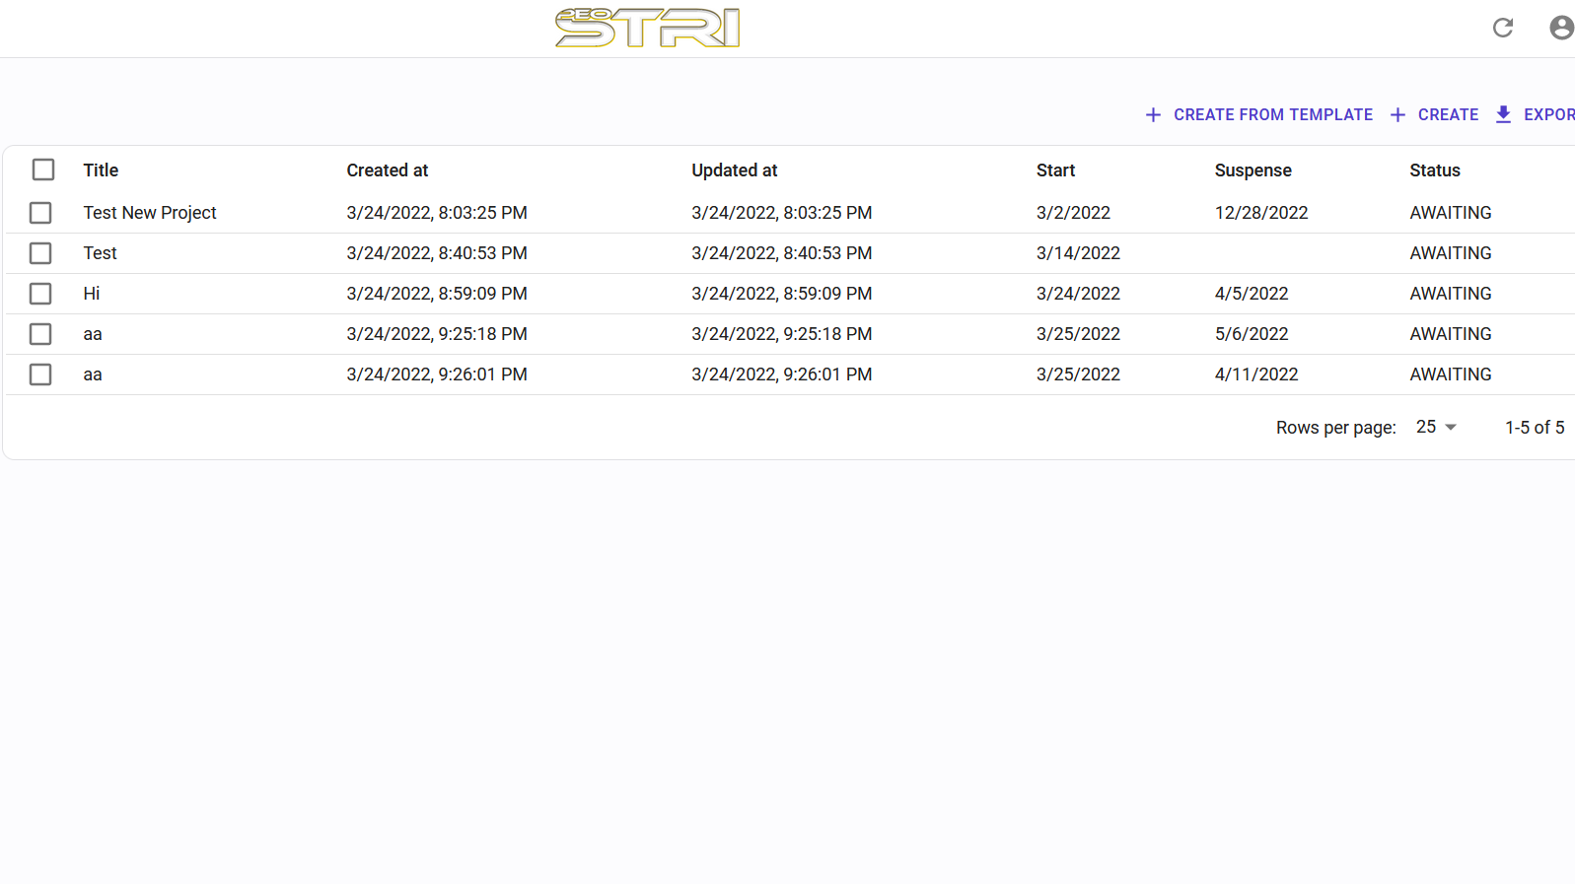
Demo

Slide 24
Ben Benyehuda
Timothy Glisson
Braden Cariaga
Henry Thiel
Business Analyst
Business Analyst
Computer Scientist
Computer Scientist
Questions?

